Slide 1

Phonics at Street Lane Primary School
We have developed our own Systematic Synthetic Phonics Programme at Street lane Primary School. We follow detailed long term and medium term planning to ensure that all GPC’s (Grapheme, Phoneme Correspondences) and Tricky words are taught in a progressive programme.
We have resources to support our teaching of phonics and we are committed to ensuring that our lessons are fun and that children learn how to decode words and develop a love of reading.
Children learn to read at individual rates and we will discuss with you any difficulties your child may be having with Phonics and suggest ways in which you can help at home.

Slide 2

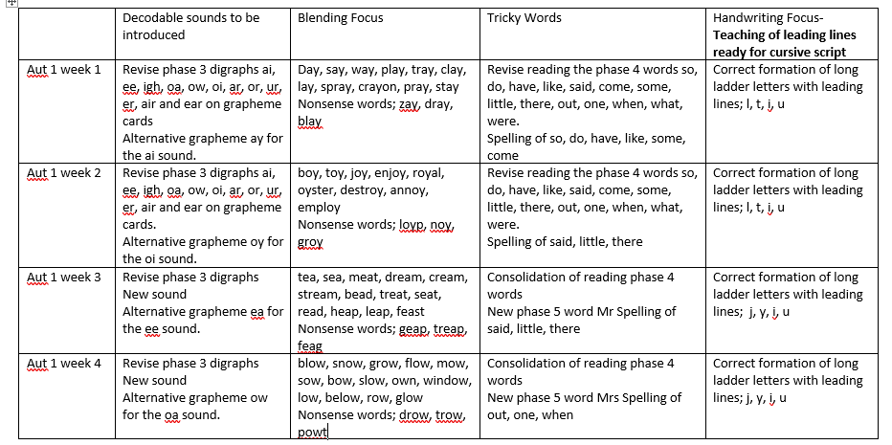
Phonics at Street Lane Primary School

Slide 3
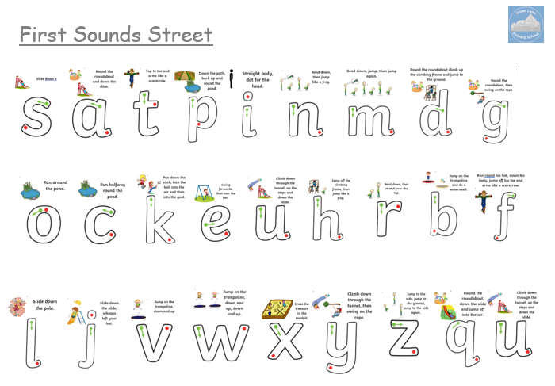

Phonics at Street Lane Primary School
Our Ducklings are beginning phase 2 which involves the teaching of the phoneme (sound) and grapheme (letter shape) that correspond together. We teach 18 single sounds and 5 strong sounds. A strong sound is when the grapheme has two letters that give the same sound eg ss, zz, ck.

Slide 4
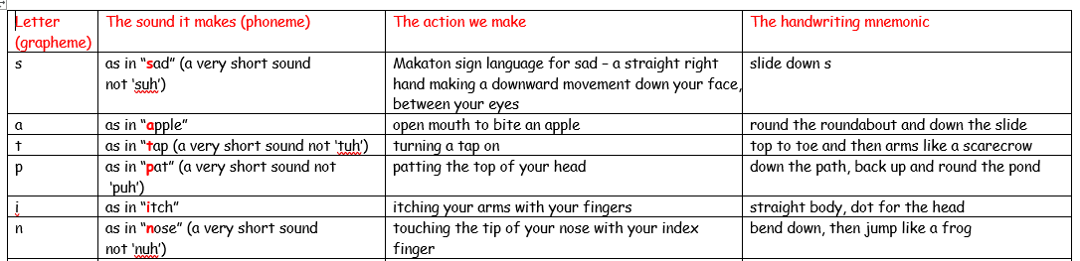
Phonics at Street Lane Primary School
The single sounds are not taught in alphabetical order but in an order where children can begin to blend the sounds together to read CVC words (consonant vowel consonant). We begin with s, a, t, p, i, n. We introduce the sound and the grapheme to represent the sound and also teach the children an action to help them to recall it if they struggle from the grapheme alone. We have a mnemonic for each grapheme to help the children with their letter formation. At this stage we focus on the initial sound and find objects that begin with the phoneme and then look at middle and end sounds in words.

Slide 5
Phonics at Street Lane Primary School
Some children already have some knowledge of phonemes, although frequently we find that the children are not using pure sounds when they say each sound. Please try to use the pure sounds with your child when reading at home. If you are unsure please ask.
https://www.youtube.com/watch?app=desktop&v=UCI2mu7URBc
At this stage we are only concentrating on the letter sounds not the letter names. Once your children are confident with the sounds and can blend them together we will then teach them the difference between sound and name. It is also important that the children do not associate capital letters with letter names only as when they are sounding out words with capital letters they will still need to use the sound rather than the name to blend the sounds together.

Slide 6
Phonics at Street Lane Primary School
Handwriting is a very difficult skill, and to prepare our children for writing we complete daily Funky Fingers sessions. These are play based activities that encourage fine motor manipulation and co-ordination which help our children to hold and control a pencil.
In addition to these activities we do Dough Disco and Wiggle While you Squiggle.
Dough Disco - YouTube
Motor Skills - Squiggle Whilst You Wiggle Part 1 - YouTube

Slide 7
Phonics at Street Lane Primary School
Once we have taught your children the first 8 sounds we will begin to blend some of these sounds together to build VC words (vowel consonant). For example, in, at, is, an. This will then progress to CVC (consonant, vowel, consonant) words. For example, sat, tap, man, tip, sit.
We use ‘robot arms’ or ‘chopping up the words’ to help support children in a way that works for them.
Words that are decodable are words that we can sound out and blend using pure sounds. For example, cat, dog, went, tent. We will practise blending decodable words every day and if the children encounter a decodable word in their book, we may refer to it as a word they can sound out to encourage them to apply the blending strategies taught in the Phonics sessions.
Phonics: How to blend sounds to read words | Oxford Owl - YouTube

Slide 8
Phonics at Street Lane Primary School
Unfortunately, not all words can be decoded. These are known as ‘tricky words’. We will begin to teach these alongside the first set of sounds straight away as they are in all of the early reading books. We will begin with I, the, to, no, go and into. We will practise these during Phonics sessions and send them home as flash cards for your child to practise.
Tricky Words and Sight Words Song - YouTube

Slide 9
Phonics at Street Lane Primary School
Reading at home will begin with a sound mat where you will play games with your child to practise recognising the graphemes and saying the correct phoneme when prompted. In the pack is a sheet with suggested activities of games you can play. We have also included copies of the grapheme mnemonics so you can practise the correct formation of letters with your child.
As soon as your child is confident with these sounds and have practised blending with us in school we will send a ‘ready to read’ pack home. This contains four CVC words and 4 pictures. The children sound out each word and match it to the picture.
From here your child will move onto a book when they are confident with the first groups of sounds and are beginning to blend independently.

Slide 10
Phonics at Street Lane Primary School
Once the children are confident with phase 2 sounds we will progress to phase 3. This is usually around Christmas time but please remember that all children learn to read at different paces and some can take a while to grasp blending.
Phase 3 sounds include the remaining 8 sounds of the alphabet and then we progress to digraphs. A digraph is where two letters are put together that make one sound. For example, sh, ch, ai.
Phase 3 sound still have an action to accompany the phoneme and grapheme. For some sounds there are alternative graphemes for the same sound, and the children have to learn to recognise both graphemes. For example ur and er.
https://www.youtube.com/watch?app=desktop&v=UCI2mu7URBc

Slide 11
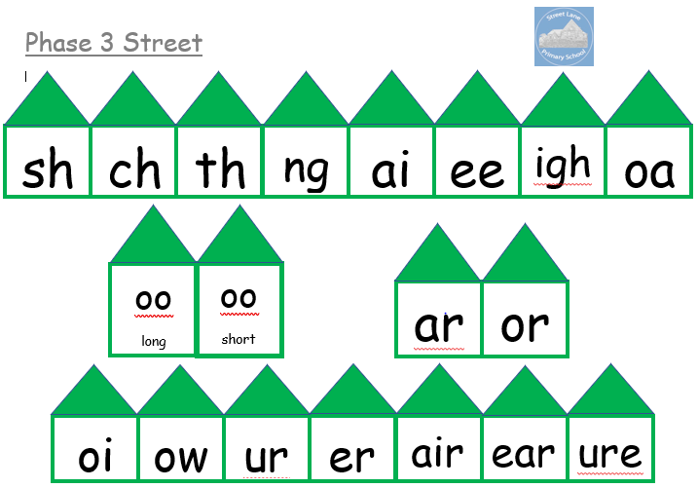
Phonics at Street Lane Primary School

Slide 12

Phonics at Street Lane Primary School
By the end of Foundation Stage 2 we aim to have covered all of phases 2 and 3 and to have made a start on phase 4. This phase does not introduce new digraphs or phonemes but focuses on blending consonant clusters and blending longer words which contain the phase 3 phonemes such as brighter, spring and squeeze.
In Year One the children will begin phase 5. During this phase the children are introduced to new digraphs such as ph and wh but the main focus is to teach alternative graphemes for the digraphs they already know. For example, in phase 3 they learn the oa sound in coat. In phase 5 they learn ow, oe and the split digraph o_e. We teach a new grapheme each week and gradually build up the vowel sound families.

Slide 13
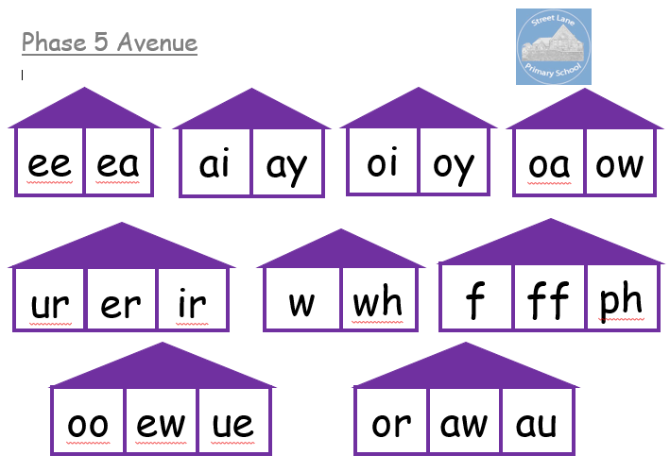
Phonics at Street Lane Primary School

Slide 14
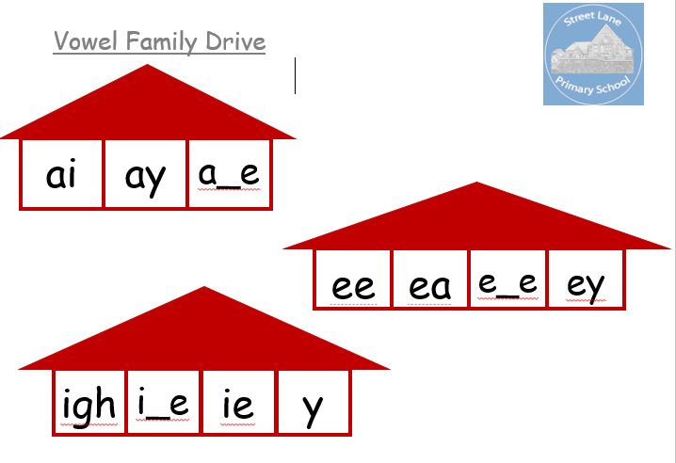
Phonics at Street Lane Primary School

Slide 15

Phonics at Street Lane Primary School
The reading books that your children will bring home will also match their stage of phonics. We will ensure that each child has the ability to decode the words and read the tricky words in the book they are reading without having to draw upon any other reading strategy.
Using picture clues, and understanding of the story so far to make predictions are examples of valuable reading skills, but these are to be taught during guided reading sessions rather than through our phonics or the independent reading scheme.
Discussion and questioning are still very important when reading with your child. Comprehension is vital to your child developing into a confident reader with a good understanding of vocabulary and story structure. Therefore, asking questions about what has happened previously, what they think is going to happen and discussing the meaning of new words is really important.

Slide 16
Phonics at Street Lane Primary School
Each week a teacher will listen to your child read and we will write a comment in their reading record. If appropriate we will suggest a target for improvement or highlight a sound or word that your child is struggling with. Please feel free to add your comments in the reading record and of course we are happy to discuss any concerns you may have with your child’s reading. It is not essential to comment each time you listen to your child, but it is helpful for staff if you date the record and then we can track the amount of reading practise your child is receiving. Practise is the key to building confident, fluent readers. Therefore, the more you can read with your child at home the more progress they will make. Five minutes three or four times a week is much more beneficial to 20 minutes in one go.
So that we can read as regularly as possible with your child can you please ensure that reading packs are in school each day and then when the opportunity arises we can squeeze a session in.

Slide 17

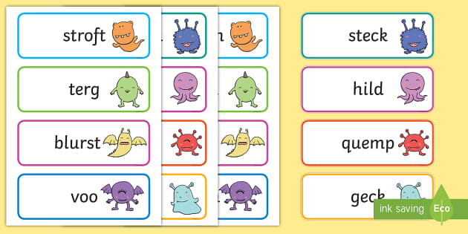
Phonics at Street Lane Primary School
Alien Words
During Phonics lessons we will also teach the children to blend nonsense or alien words. This is to consolidate their recognition of the graphemes and to encourage confident ‘decoders.’
As soon as the children are confident with the sounds, we like to present them with real words they will meet in their reading books and nonsense words so that they are familiar and comfortable with them.

Slide 18
Phonics at Street Lane Primary School
At the end of Year One (June) the children will complete their Phonics Screen test. During this the children are shown a selection of real and nonsense words and they have to decode and read each one. The children read a total of 40 words and the pass mark is usually 32 or 33.
As our children move into Year 2 we will move away from the language of phase and focus on the objectives specified in the National Curriculum. This overlaps with what was previously known as phase 6 and is where the children learn to extend their reading skills to include knowledge of prefixes, suffixes, silent letters, homophones and contractions.
They will become more fluent and confident readers and their reading books will reflect this. Texts will be more thorough with wider vocabulary and comprehension skills will become more of a focus.

Slide 19
Phonics at Street Lane Primary School
Phonics Support at Home
As mentioned earlier practise is the key to success with phonics. Reading books and flash cards are only one way that you can help to support your child’s phonics. We subscribe to Phonicsplay and use the games daily in class to enable us to complete regular practise without the children becoming complacent with the same activities.
PhonicsPlay
Using the username and login ‘Streetlane1!’ the children can log on at home and continue to practise games that have been introduced to them in class.

Slide 20

Phonics at Street Lane Primary School
Other websites that I find useful include;
https://www.phonicsbloom.com/uk/game/alien-escape?phase=4
http://www.letters-and-sounds.com/phase-5-resources.html
https://www.ictgames.com/mobilePage/literacy.html
https://www.ictgames.com/mobilePage/helpAHedgehog/index.html
https://www.ictgames.com/mobilePage/dinosaurEggsHF/index.html
https://www.ictgames.com/mobilePage/forestPhonics/index.html
Phase 3 tricky words - Teaching resources (wordwall.net)

