Slide 1

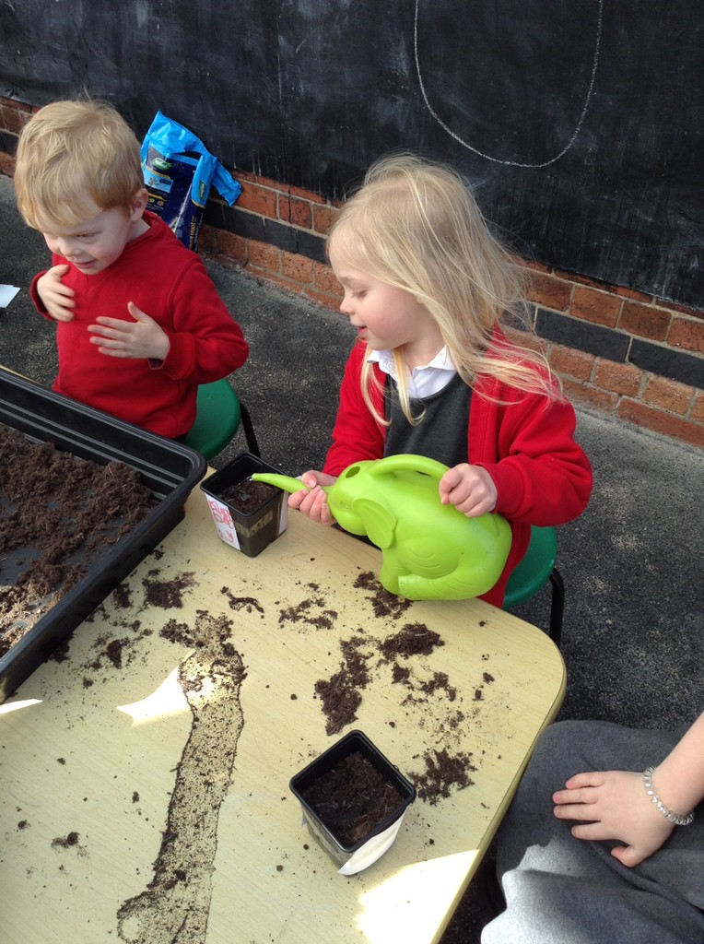
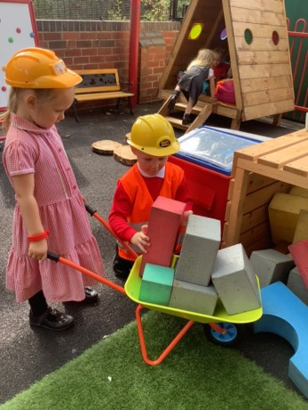
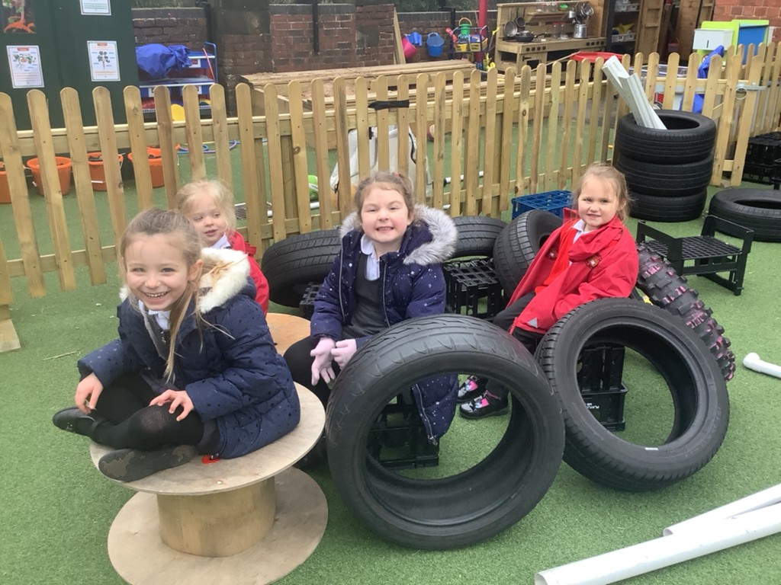
Information for Parents of children In Duckling’s Class
15th June 2022

Slide 2
Early Years Foundation Stage
The EYFSP is the curriculum document that we follow for the first year of school. Your children will already have achieved parts of the profile as it covers their development from birth. Any previous setting that your child has attended will have highlighted developmental points that your child has achieved.
The EYFSP is divided into 7 areas of learning.
3 prime areas 4 specific areas
Personal, Social and Emotional Development Literacy
Communication and Language Mathematics
Physical Development Understanding the World
Expressive Arts and Design

Slide 3
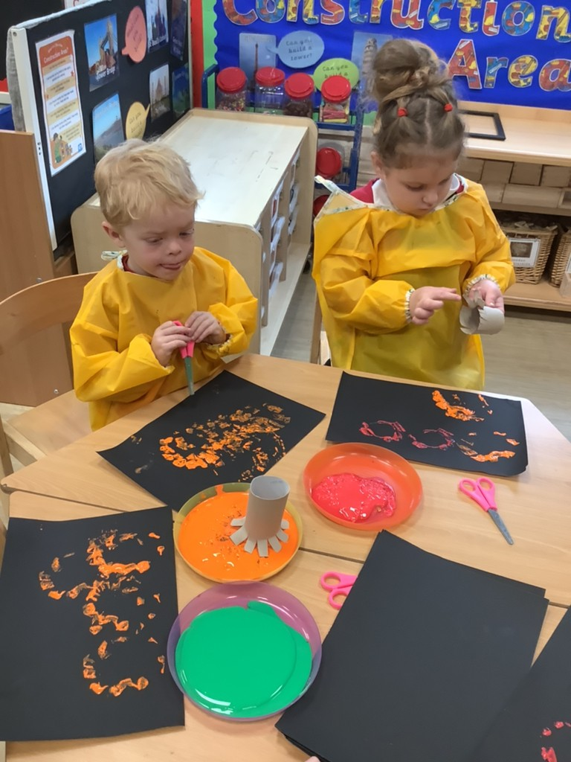
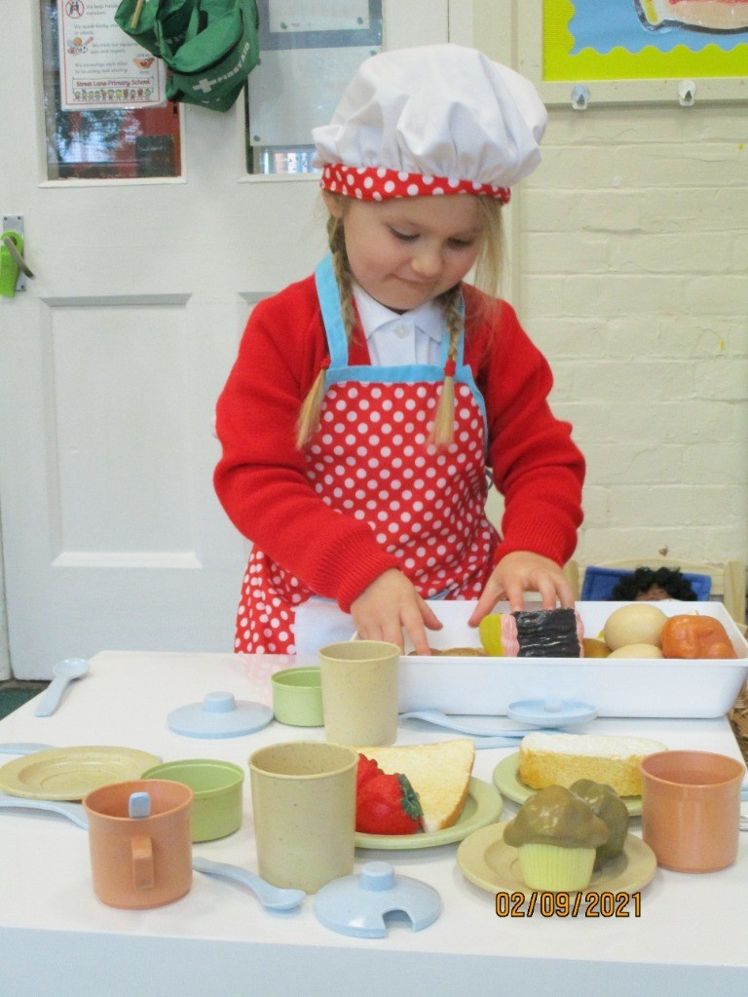
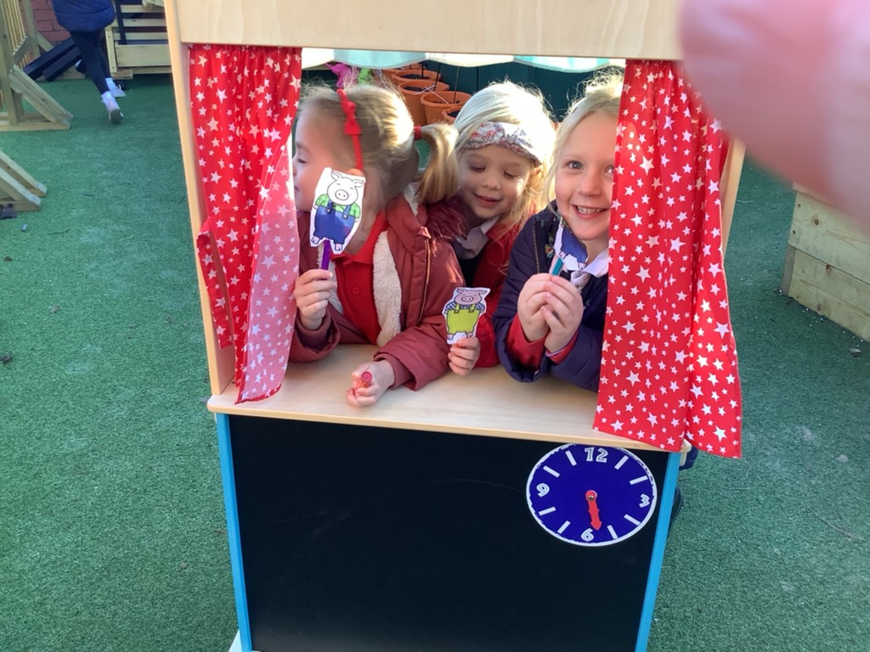
We teach this curriculum through play!

Slide 4
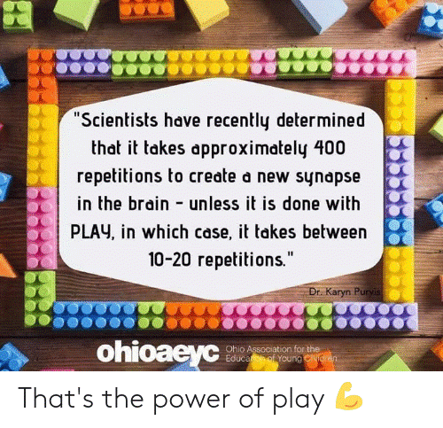

Slide 5
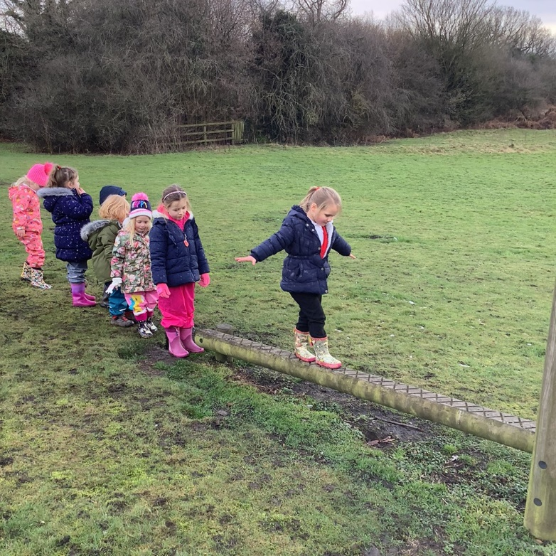
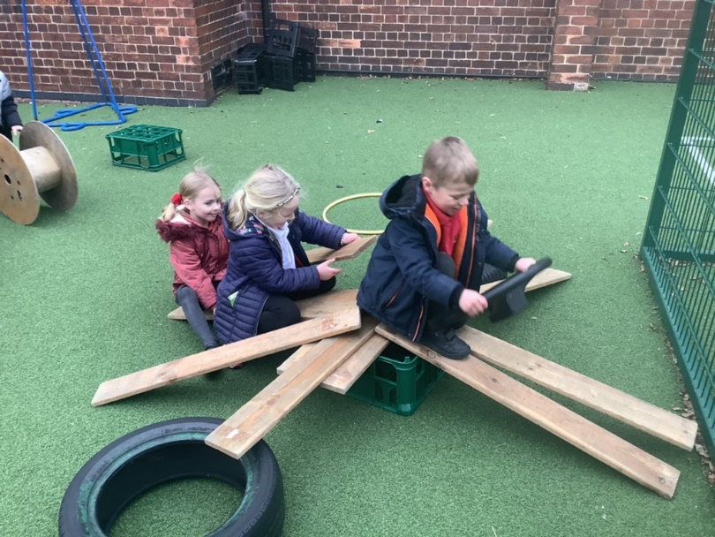
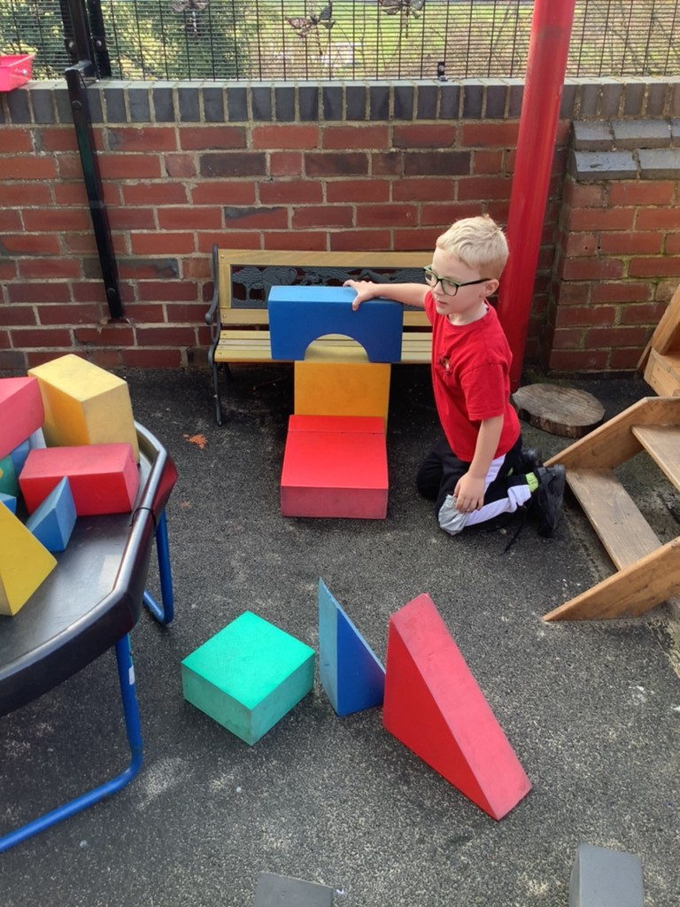
Outdoor Learning
Whenever possible we operate a free flow classroom
so the children can decide for themselves if they
wish to learn inside or outside. We also use the
garden area and park to support the children’s
learning, especially for Physical Development and
Understanding of the World.
The children play outdoors whatever the weather
so we do ask that you provide wellies and a puddle
suit. This is especially useful when the children play with our water
wall and we roll down the hill in the park!

Slide 6
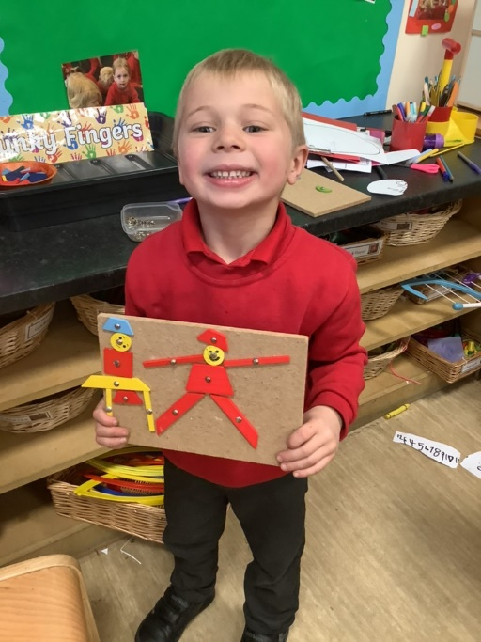
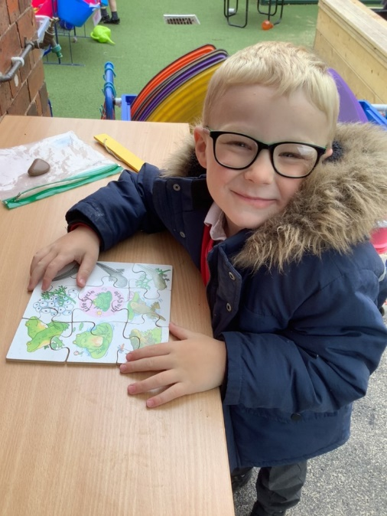
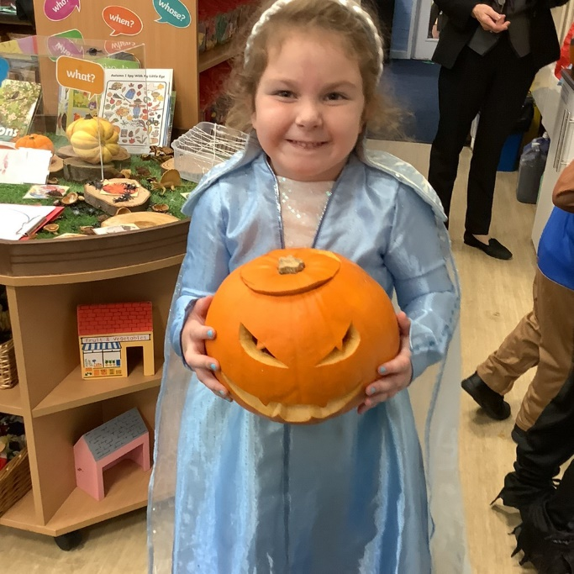
Every Child a Talker (ECaT)
To help support your child with their Communication and Language we have daily ECaT sessions. Each week we will send home a sheet with a song, suggested activities you can share with your child and Makaton actions that we will teach your children to support communication.
During the session your child will have the opportunity to show the class the work they have produced and talk about the activities they have completed at home.
ECaT really helps to boost confidence and gives the children chance to share their individual experiences.

Slide 7
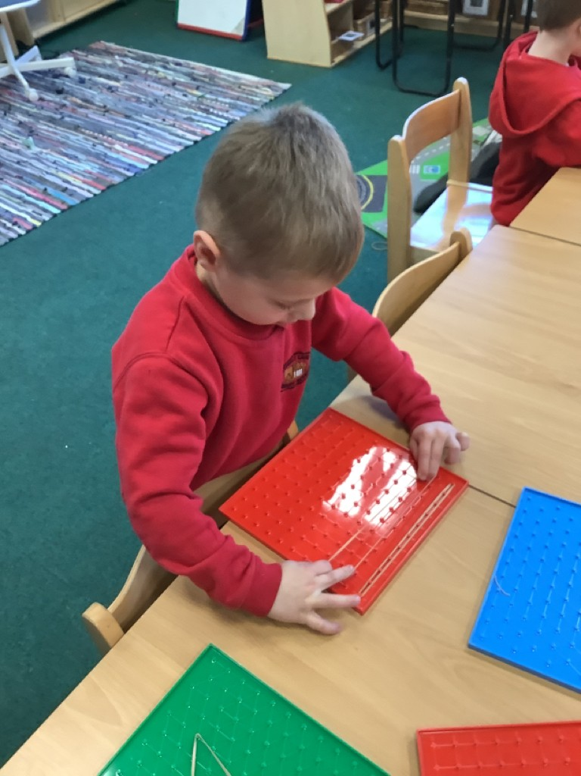
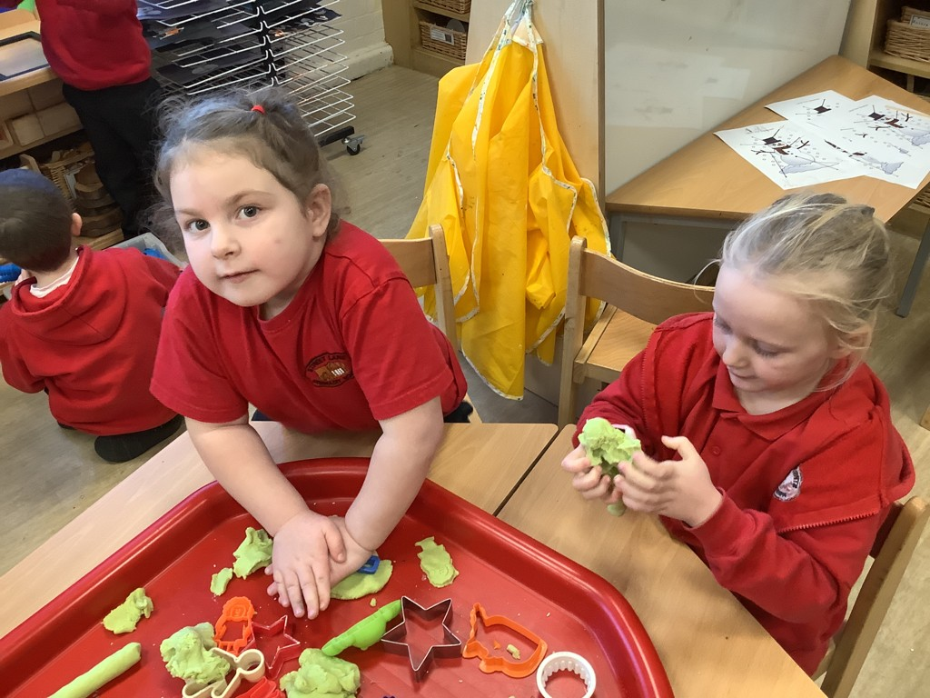
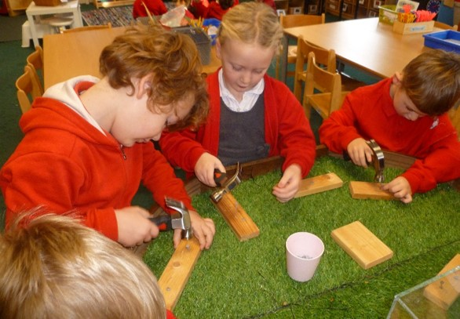
Funky Fingers!
Funky Fingers is an introduction to writing. Practising fine motor skills helps the children to improve the movement of their fingers and to develop
co-ordination. Holding a pencil correctly is a skill which needs to be taught!
Funky Fingers activities are short and fun but require lots of focus and concentration.

Slide 8
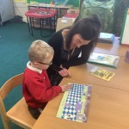
Phonics
We will begin teaching Phonics from week 2 and follow our own systematic synthetic phonics programme based on what was Letters and Sounds. There will be a meeting during the first half term to provide further information on how we teach Phonics.
If you practice sounds with your child please ensure that you are using pure sounds. Please use this link to hear the sounds.
https://www.youtube.com/watch?v=UCI2mu7URBc
We will assess where your child is with their phonics and then send home a pack that is appropriate for their stage of development. Mostly this will be a sound mat to start with, but if your child is already blending words they may be ready for a ‘Ready to Read’ pack.
Reading at home is crucial to learning to read and developing a love of reading! Five minutes each day is more beneficial than half an hour once a week.

Slide 9
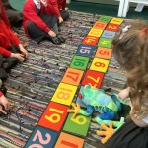
Timetable
In the Autumn Term the children will have a mixture of directed
teaching sessions and independent choosing time.
Directed teaching time will be short bursts throughout the day. We will have daily Phonics, Maths, Funky Fingers and ECaT sessions which will last between 10 and 15 minutes.
Throughout the week the children will also be taught RE as a focused session. Other subject areas covered through our continuous provision planning. This is predominantly child led but we will also provide appropriate adult led enhancements. These enable us to plan opportunities to play with your children and extend their learning appropriately.

Slide 10
Lunch Time
Dinners are free for children in EYFS and KS1. A menu is available online and there is one in your pack. There is also a sandwich or jacket potato option if your child does not like the meal. However this needs to be pre-ordered via the school office.

Slide 11

Sharing your Child’s Learning
We use an online assessment tool known as Tapestry to share your child’s learning journey with you. This involves staff taking a photograph of your child’s learning, writing a comment and making links to the EYFSP and characteristics of effective learning. You can also upload learning from home and we will ‘like’ it or comment on it and your child can share your posts with the rest of the class. There is an introduction to Tapestry powerpoint on our new starters page.
We will need an email address and your
permission to allow us to photograph your child.
There is a form in your pack, please ask if you require further information.

Slide 12
Useful Information!
The children will start school on Monday 5th September. School does begin at 8.50 however on the first day we are asking that you bring your child for 9.00. This will allow all of our current children to come into school and leave the entrance to school less busy for our new starters on their first day.
Children in EYFS do not have a specific taught PE lesson. We cover the physical development objectives through our carefully planned provision. However we will let you know when we will be taking the children across to the park.
Please send your child with a drink and healthy snack each day. We encourage the children to bring in fruit snacks so please no crisps or chocolate and only water in water bottles. We do provide a fruit snack and milk. Please ensure all of your child’s belongings are named including snack boxes and water bottles.
If your child is unwell and unable to attend school please contact the school office and explain their absence.

Slide 13
Your Packs
You should have found an information pack on your chairs. Please complete the forms and return them to school by the first transition visit on Wednesday 29th June. We will need emergency contact information and allergy/ health information before you can leave your child in our care. We also need to see your child’s original birth certificate, if you haven’t brought it today please drop it in for us to copy.
We would like to draw your attention to the Tapestry form and the Permission to Collect form.
Your child’s safety is our main priority and therefore we will only release your child at the end of the day to an adult that you have specified on your form. Of course there will be instances where you need a different adult to collect and we just ask that you ring the office or speak to a member of staff to give your permission for your child to leave with another adult. If we have not had permission from you we will not release your child.

Slide 14
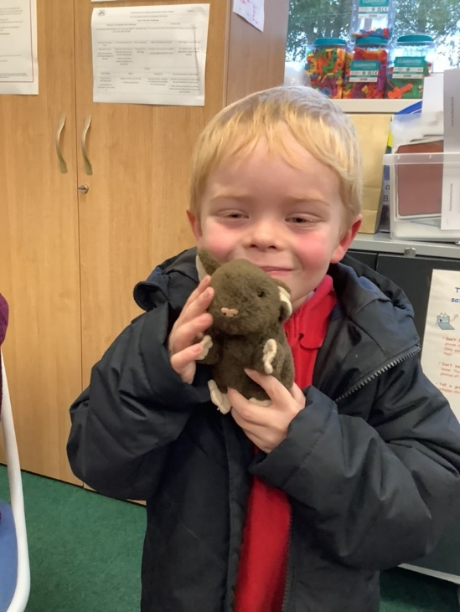
And finally…
We are really looking forward to welcoming your child to school in September
We have arranged 2 transition visits which your child is invited to attend. These are on Wednesday 29th June 1.30-2.30pm and Wednesday 6th July 1.30- 2.30pm. On these visits, please ensure your child has a coat and suitable footwear and a named water bottle please.
We would now like to give your child a small friend to take care of
over the Summer holidays and to help them get ready for the
exciting new adventure of starting school!

